Slide 1



Neuro-Symbolic AI for conflict-aware learning over Knowledge Graphs
Laura Balbi
Supervised by Cátia Pesquita
LASIGE Research Unit, Department of Informatics
Faculty of Sciences of the University of Lisbon, Portugal

Slide 2









Contradictions in Knowledge Graphs
Real-world KGs aggregate information from heterogeneous sources (multiple databases, annotators, automated extractors)
Real-world knowledge inherently includes ambiguity and contradictions
Contradictions can reflect multiple views valid in their own context/under a given assumption
This leads to conflicting statements and ambiguous entities/events
KG Representation Learning (KGRL) is not able to handle contradictions
e.g. Wikidata [1] entry for Jerusalem:
< Jerusalem, wiki: capitalOf, S. Palestine >
— disputed by USA & Israel
< Jerusalem, wiki:capitalOf, Israel >
— disputed by United Nations
Laura Balbi
[1] https://www.wikidata.org/
Notes:
Knowledge Graphs are often treated as consistent factual knowledge sources for several applications — but in reality, due to integrating information from heterogeneous sources, they often also introduce contradicting information.
And common KG representation learning is not able to deal with contradictions, so the common approach is to either ignore or eliminate them.
However, not all contradictions mean that a side is ‘wrong’; sometimes, they reflect how real-world knowledge can vary depending on different points-of-view and context.
Let’s look at this example retrieved from Wikidata, where Jerusalem is linked by the relation wiki:capitalOf to both the S. of Palestine and Israel. This reflects their ongoing geopolitical conflict where under specific contexts either of these statements can be considered true.
Ideally, by including these complimentary views on a subject, KGs would be able to represent the real-world more accurately and capture the polyvocality of complex domains – such as science and politics and general knowledge.

Slide 3
Contradictions in Knowledge Graphs
KGs with explicit contradictions mirror real-world knowledge
that should be modeled and exploited for ML!
But this would mean tackling…
Contradiction ≥ 1 side is wrong
(but often both statements are contextually true)
Common assumptions
Proximity = similarity/relatedness
(conflicting edges close in the graph will be modeled similarly)
Notes:
But this kind of representation would entail having to tackle some major common assumptions that current KGRL approaches follow,
such as considering contradictions as logical violations where at least one side is wrong and assuming that proximity, or connectivity, in a KG implies similarity.

Slide 4
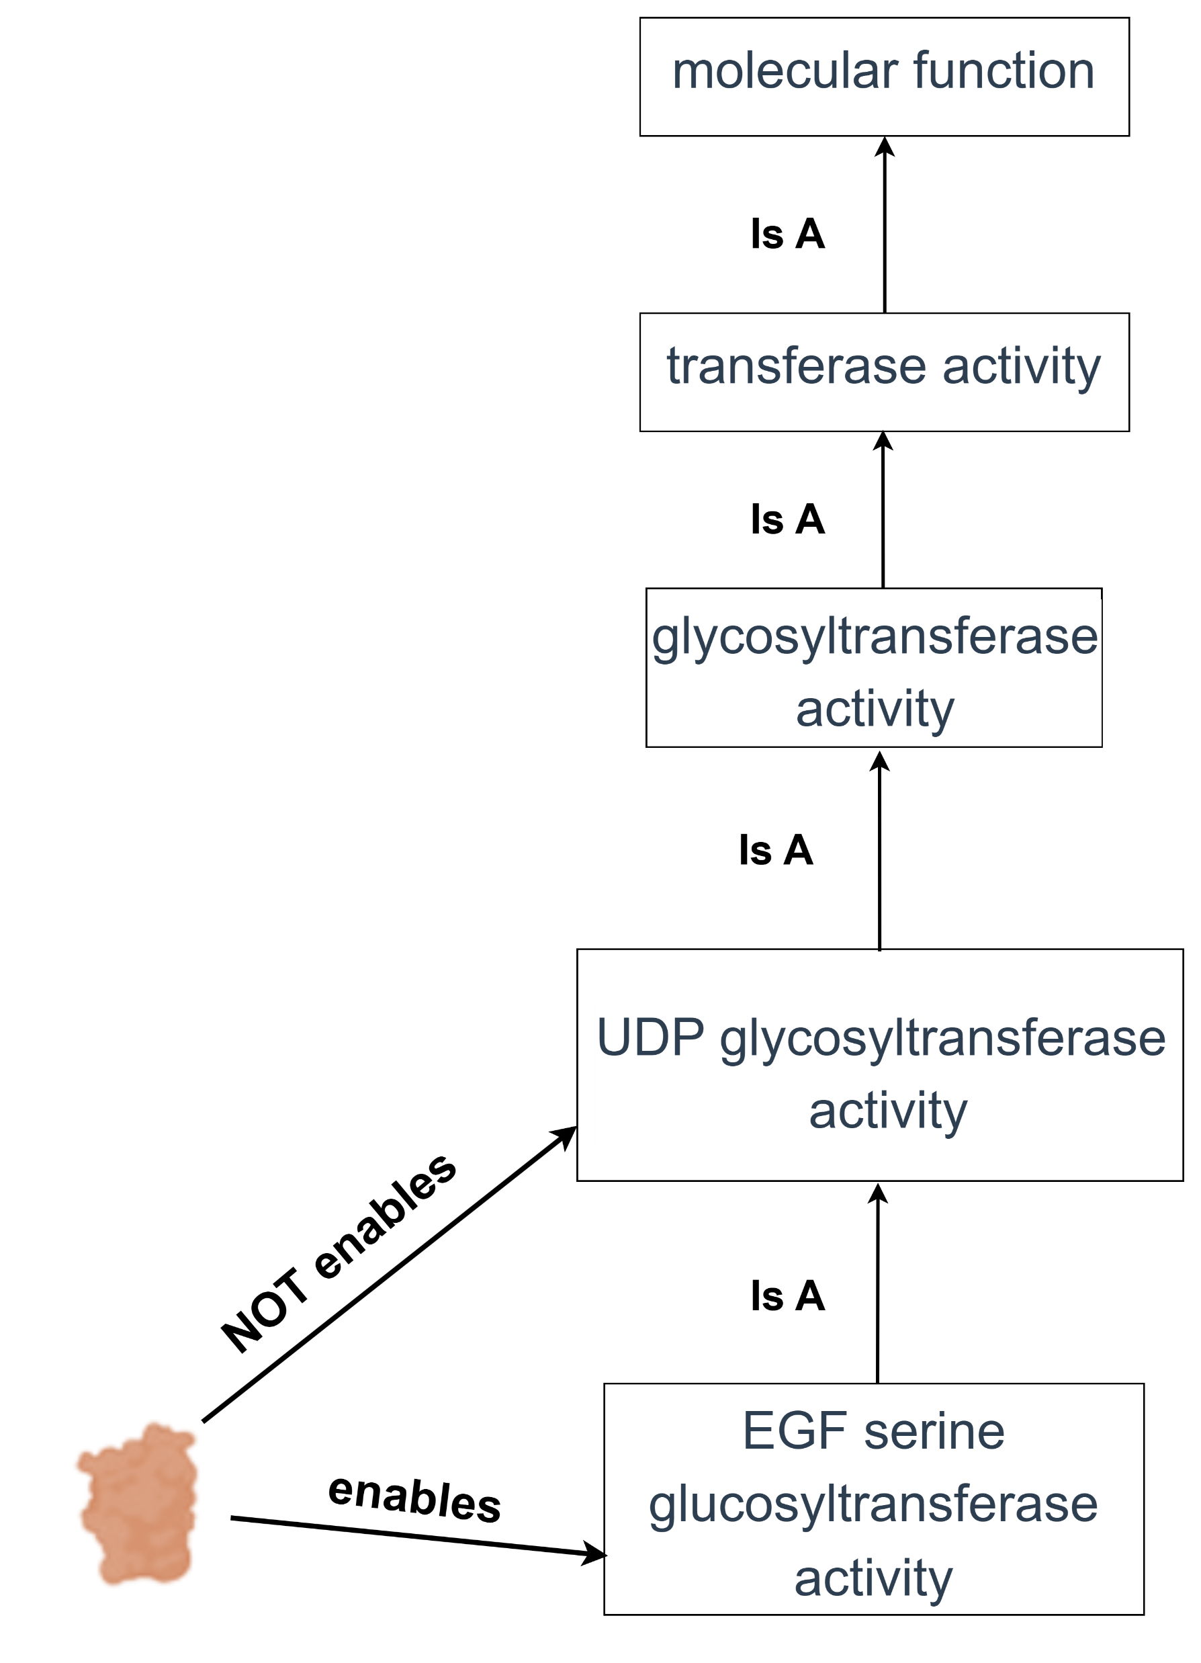
Use-cases with contradictions
Scientific domain – continuously evolving scientific knowledge; different experimental conditions or contexts produce conflicting outcomes
General domain – statements from diverse and conflicting viewpoints
Jerusalem, wiki:CapitalOf, S. Palestine — “disputed by USA & Israel”
Jerusalem, wiki: CapitalOf, Israel — “disputed by UN”
Gene Ontology description for Transferase PLGT2
(UniProt Q6UW63)
Explicit contradiction
Implicit contradiction
Ambiguous value but no logical violation: Wikidata’s semantics allow for “Jerusalem” to be associated to more than one country
(no cardinality for wiki:CapitalOf)
Logical violation of the Gene Ontology’s semantics through negation.
Common solution
Possible solution
Detected by reasoners & rule-based logic; valid under specific bio-contexts
Combining symbolic and sub-symbolic systems to leverage external knowledge as the missing semantics – e.g. LLMs with domain KGs, ontologies.
Laura Balbi
Notes:
So as said before, two of the domains where it is common to have contradictions stemming from different narratives and where contradictions have been proven to exist are the general and the scientific domain.
In the scientific domain, we have an example on how there are statements to the Gene Ontology that describe transferase PLGT2 as both having “serine glucosyltransferase activity” and not having ‘glucosyltransferase activity’— when the ontology classifies ‘glucosyltransferase activity’ as being a superclass of “serine glucosyltransferase activity” and therefore including it.
This example is a clear violation of the ontology’s semantics and therefore can be detected with rule-based logics or a reasoner – this is what we call an explicit contradiction. This doesn’t mean that both statements cannot be correct under different experimental conditions;
but there is a difference between this explicit contradiction and the general knowledge domain example of Jerusalem that will not be detected since there is no actual KG restriction being violated – because in the Wikidata there is no limit as to how many countries a region or city can belong to – so this is an example of an implicit contradiction.
These contradictions require a more complex detection method than just logical reasoning, with the introduction of extra semantics to make the logical violation obvious and allow detection.
So there is potential in combining a sub-symbolic component with symbolic systems, for example, LLMs with KGs, to introduce the missing semantic context.

Slide 5
Hypothesis
Recap
Contradictions may represent different facets of a complex, multifaceted truth.
Current KGRL overlooks this and how modeling contradictions explicitly could enhance the applicability of KGs and the accuracy and of ML approaches over KGs.
Hypothesis
A neuro-symbolic approach that integrates symbolic and sub-symbolic representations can bridge KGs and LLMs to model contradictions and explore them into KG entity representations for use in downstream ML tasks.
Laura Balbi
Notes:
So given how under-explored the truth-values of contradictions are (namely implicit ones)
We hypothesize that by developing a neuro-symbolic approach that bridges KGs and LLMs to detect contradictions and model and explore them into KG representations for use in downstream ML tasks, we would be able to perform a study that explores the potential role of contradictions in generating representations.

Slide 6
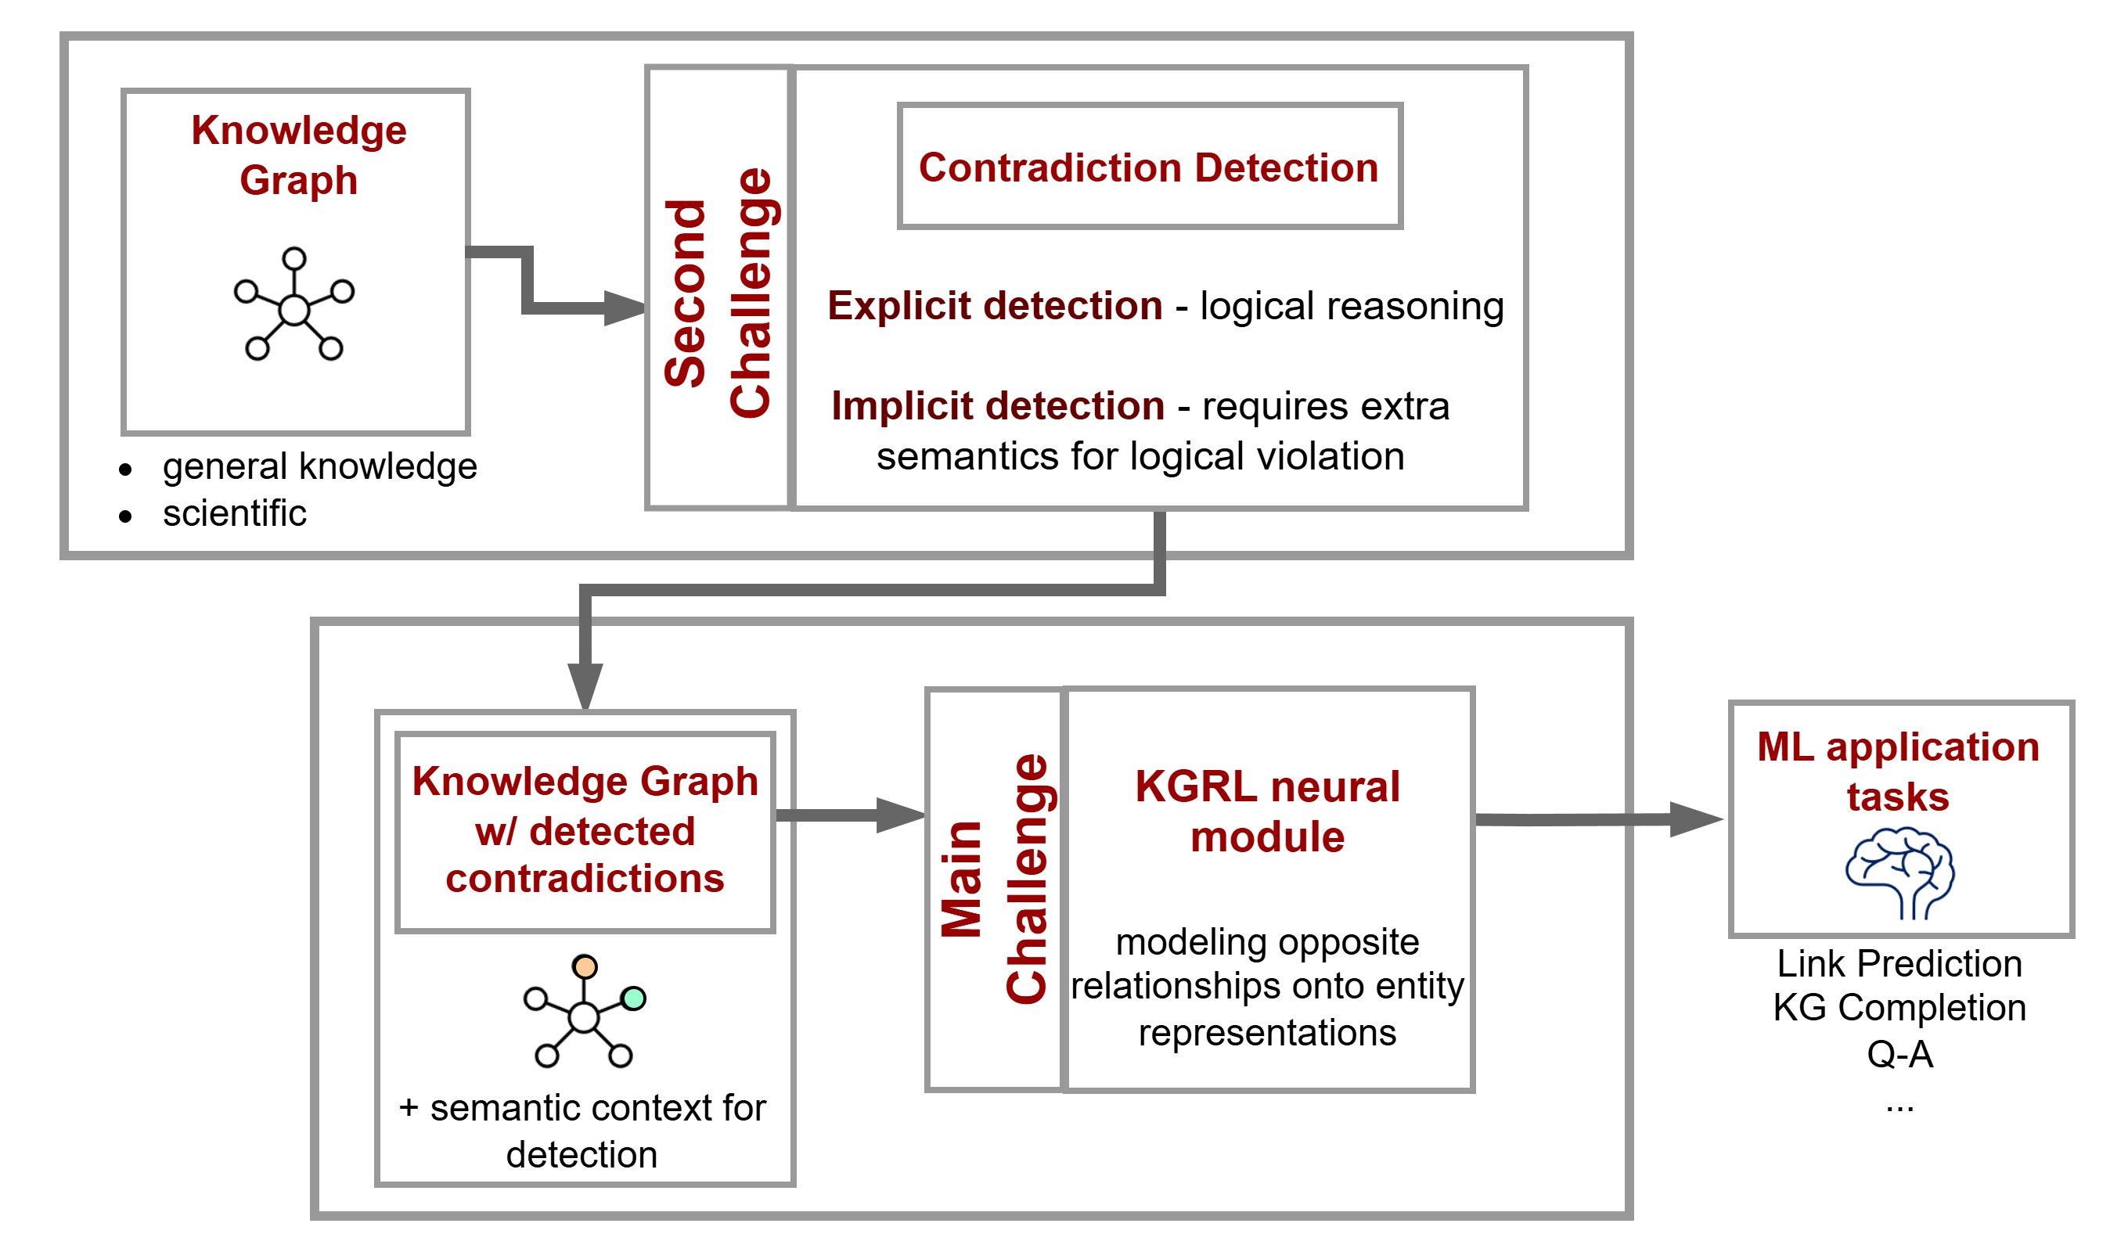
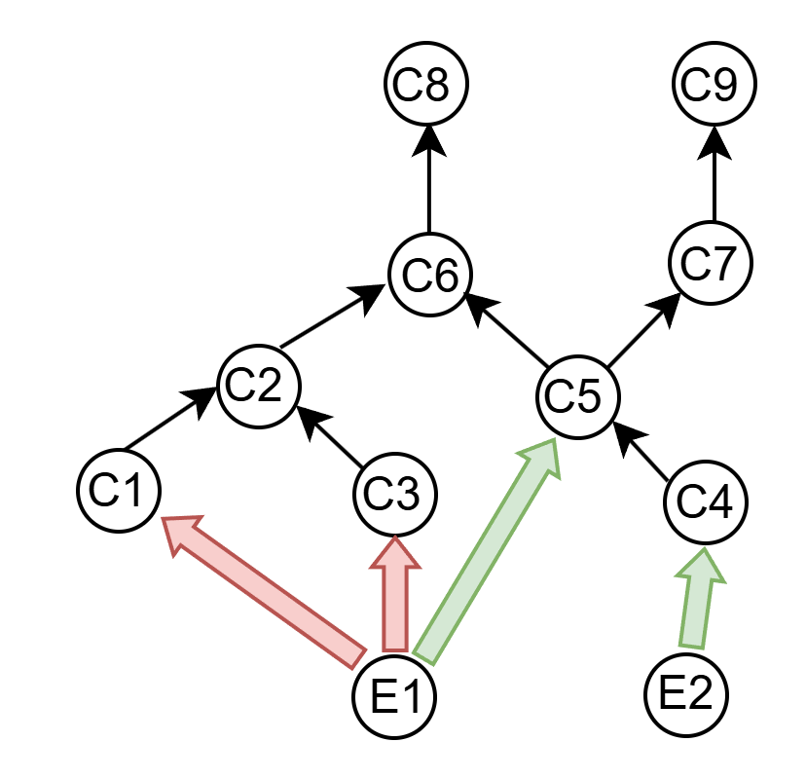
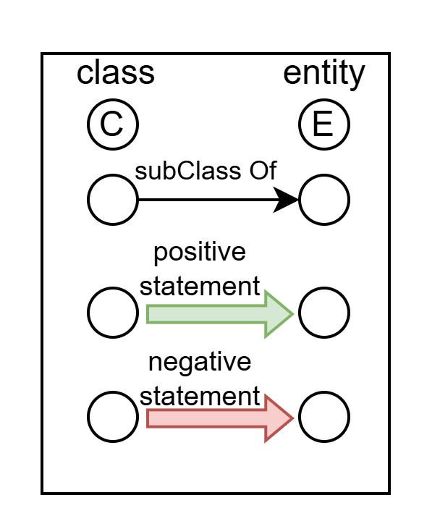
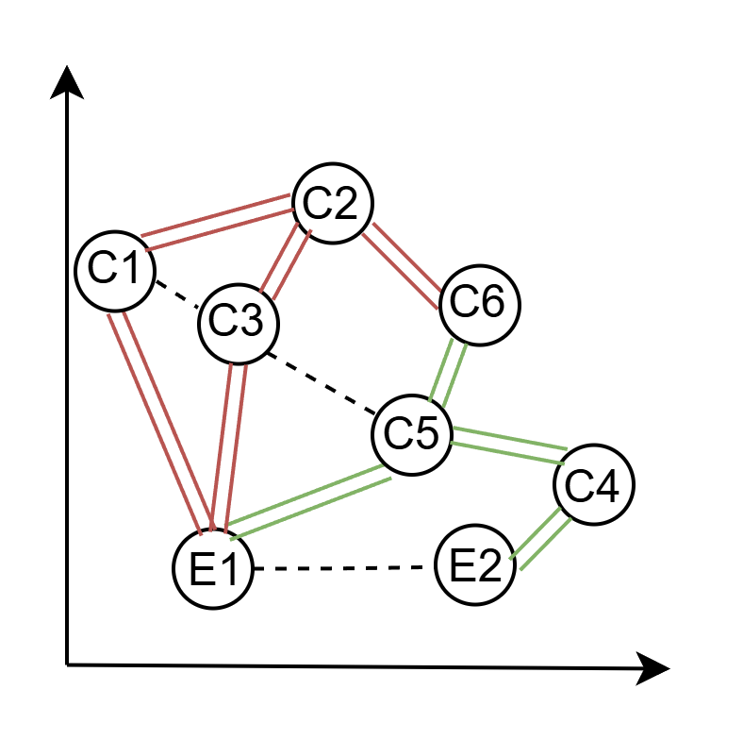
Methodology
modeling opposite relations
Separate negative and positive relations
Approximate negative neighbors of the same node and relation type
Laura Balbi
Notes:
So to support this hypothesis, we’ve designed a framework where we present our main challenge in introducing contradictions onto KGRL
which is how their modeling mechanisms will need to distinguish between opposite relations when generating representations for entities involved in conflicts.
For example in the simplest of cases, with negation-based contradictions, the notion of proximity cannot be transposed from positive neighbors to negative ones.
A positive relation should pull neighbors together while a negative relation should push them apart. Moreover, the different values neighbors themselves should repel each other.
However, to reach this modeling step we still need to overcome the challenge of detecting contradictions, namely implicit ones, with the introduction of the extra semantics required for them to be detected.
Only after tackling these challenges can we compare these approaches against traditional KGRL over different domain use-cases and tasks to study the impact of modeling contradictions.

Slide 7

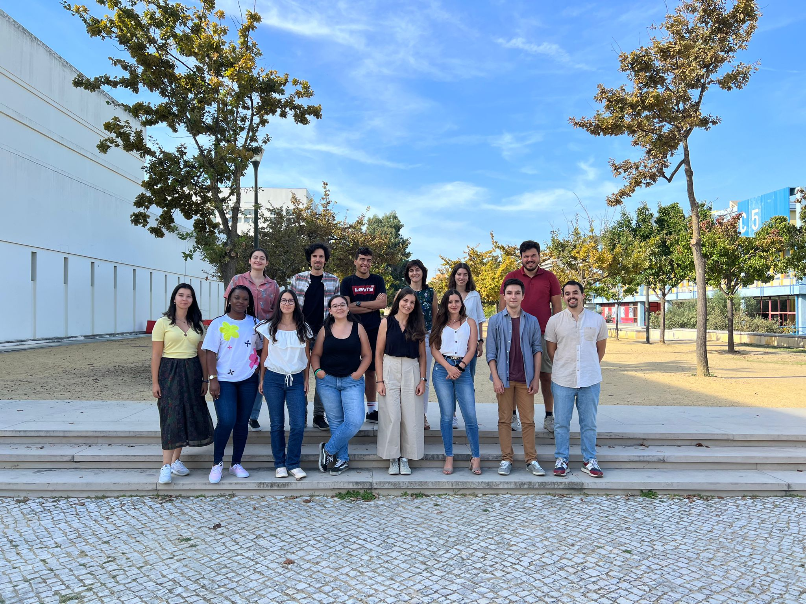



Acknowledgements & Team
This work is supported by FCT through the fellowship 2024.01208.BD, and the LASIGE Research Unit, ref. UID/00408/2025.
It is also partially supported by the KATY project which has received funding from the European Union’s Horizon 2020 research and innovation program under grant agreement No 101017453.
Supervisor: Catia Pesquita
Contacts:
lbalbi@lasige.di.fc.ul.pt
https://github.com/lbalbi
Notes:
Thank you for listening to my presentation and I am very open to any questions, insights or posterior contacts.
I would also like to thank my supervisor Catia Pesquita and our team at LISEDA for their support of this work.

